Slide 1
Flow Architecture and Introduction to Redux

Slide 2
Objectives
Discuss the features of the Flux architecture
Explain the Redux approach to implementing a variant of the Flow architecture
Install and Configure Redux in your application
Enable your React app to make use of Redux

Slide 3
Model-View-Controller Framework

Slide 4
Design Patterns
Well-documented solution to a recurring problem
Also referred to as an architectural pattern
Software design pattern
Reusable solution to commonly occurring problems
Gang of four: E. Gamma et al. Design Patterns: Elements of Reusable Object-Oriented Software, Addison-Wesley, 1994
https://en.wikipedia.org/wiki/Software_design_pattern

Slide 5
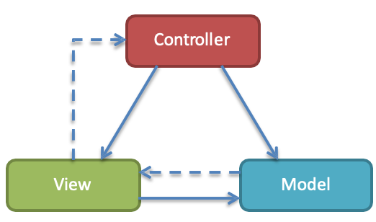
The Model-View-Controller (MVC) Framework
Software engineering architecture pattern
Isolation of domain logic from user interface
Permits independent development, testing and maintenance (separation of concerns)

Slide 6
MVC Framework
Model
Manages the behavior and data of the application domain
Responds to requests for information about its state (usually from the view)
Responds to instructions to change state (usually from the controller)
In event-driven systems, the model notifies observers (usually views) when the information changes so that they can react

Slide 7
MVC Framework
View
Renders the model into a form suitable for interaction, typically a user interface element
Multiple views can exist for a single model for different purposes
A viewport typically has a one to one correspondence with a display surface and knows how to render to it

Slide 8
MVC Framework
Controller
Receives user input and initiates a response by making calls on model objects
A controller accepts input from the user and instructs the model and viewport to perform actions based on that input

Slide 9
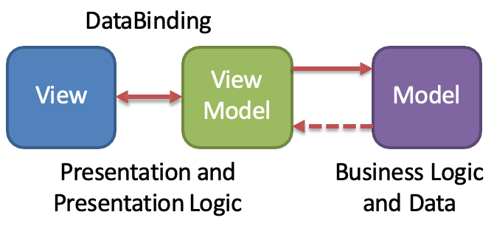
Model View View-Model (MVVM)
Descendent of MVC
Sometimes called Model- View-Binder
View model
Abstraction of the view that exposes public properties and commands
Declarative data binding

Slide 10
The Flux Architecture

Slide 11
React and MVC
Initially React was viewed as the “V” in MVC
Not emphasized any more
Facebook found issues with using the standard MVC architecture pattern
Discarded in favor of the Flux architecture
Problems with cascading updates, decentralized mutations, race conditions

Slide 12
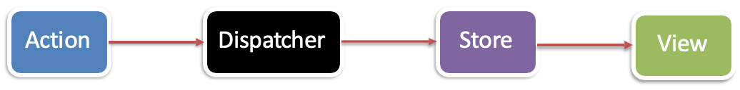
The Flux Architecture
Unidirectional Data Flow

Slide 13
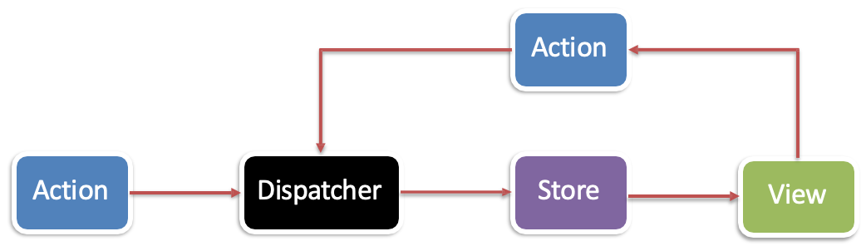
The Flux Architecture
New actions propagated through the system in response to user interactions

Slide 14
Introduction to Redux
What is Redux?
Predictable state container for JavaScript apps
Inspired by Flux, Elm, Immutable
Makes state mutations predictable

Slide 15
Main Principles of Redux
Single source of truth
Single state object tree within a single store
State is read-only (only getters, no setters)
Changes should only be done through actions
Changes are made with pure functions
Take previous state and action and return next state
No mutation of the previous state

Slide 16
What is Redux
Single store and single state tree enables powerful techniques:
Logging
API handling
Undo/redo
State persistence
“time-travel debugging”

Slide 17
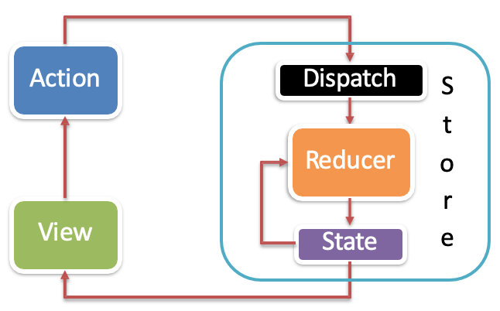
Redux Data Flow
Uni-directional data flow

Slide 18
Redux Concepts
State: stored in plain JS object
Action: plain JS object with a type field that specifies how to change something in the state
Reducer: pure functions that take the current state and action and return a new state
Update data immutably (do not modify inputs)

Slide 19
Redux Store
Holds the current state value
Created using createStore()
Supplies three methods:
dispatch(): states state update with the provided action object
getState(): returns the current stored state value
subscribe(): accepts a callback function that will be run every time an action is dispatched

Slide 20
React with Redux
Use the react-redux package for bindings between React and Redux
connect(): generates a wrapper “container” component that subscribes to the store
Surround your App root with <Provider>
Takes the store as an attribute
Makes store accessible to all connected components

Slide 21
React with Redux
The connect() function takes two optional arguments:
mapStateToProps(): called every time store state changes. Returns an object full of data with each field being a prop for the wrapped component
mapDispatchToProps(): receives the dispatch() method and should return an object full of functions that use dispatch()

Slide 22
Exercise 35: Introduction to Redux
Install and configure Redux within your application
Configure your React application to make use of Redux

Slide 23
React Redux Form

Slide 24
React-Redux-Form
A versatile, fast, and intuitive library for creating complex and performant forms in React and Redux
Collection of reducer creators and action creators
Form data stored in Redux store in a model
Validation support for forms

Slide 25
LocalForm
Maps form model to local state of the component
Suitable when you don’t need form data persistence across component mounting/unmounting
Can still perform form validation using support from react-redux-form

Slide 26
Exercise 36: React Redux Form and React Redux Form Validation
Install and configure react-redux-form
Implement a controlled form using react-redux-form
Configure and implement simple form validation for controlled forms designed using react-redux-form

Slide 27
Summary
Discuss the features of the Flux architecture
Explain the Redux approach to implementing a variant of the Flow architecture
Install and Configure Redux in your application
Enable your React app to make use of Redux

